Slide 1
COMP 2710 Software Construction
The Simple Software Process
Dr. Alvin Lim
Auburn University
http://www.eng.auburn.edu/~lim
limalvi@auburn.edu
Fall 2014
These slides are adapted from notes by Dr. Winard Britt
1-<number>

Slide 2
Where we will go with this…
Why bother?
“Classical Model” – the Waterfall
OO Analysis
OO Design
Test Cases
1-<number>

Slide 3
The Problem
Nobody needs “average” or sloppy programmers anymore. The value of low quality software is getting lower and lower.
  Not marketable
Quality is necessary, marketable, and valuable
“Ad Hoc” programming is not scalable to large systems
1-<number>

Slide 4
Why bother with Software Process?
Lower bug rates
Lower maintenance costs (huge!)
Large developments become tractible
Absolutely necessary to guarantee any sort of quality (Space Shuttle, expert systems)
Necessary for most contractors, government, etc.
1-<number>

Slide 5
The Waterfall Lifecycle (from Wiki)
Analysis of Requirements/specification
Design
Implementation
Integration
Testing and debugging
Maintenance
1-<number>

Slide 6
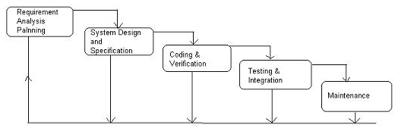
The Waterfall Lifecycle
1-<number>

Slide 7
Note: Ordering in the Waterfall should not be taken too seriously!
Too rigid
Does not model the way humans do work (finish everything in one step before you start the next)
Should use phases only as guidelines, utilize an iterative pattern
1-<number>

Slide 8
Process in OO World
Think about problems in terms of data and how operations on that data should be defined
1-<number>

Slide 9
OO Analysis
What is the big picture of this problem?
  What (“real-world”) objects exist in the system?
  How do objects interact?
    It’s okay if not all “real world objects” map directly to software objects
2) Exactly how will this system be used? (Use Cases)
  Describe (in English) scenarios of use. Generally, we at first only consider nominal use cases.
1-<number>

Slide 10
Example: Digitized Library
1) What is the big picture of this problem?
The goal of the system is to allow users to check out books using an automated system using their student ID.
Where are the potential objects?
1-<number>

Slide 11
Let’s make it easier…
The goal of the system is to allow users to check out books from the library using an automated system using their student ID.
These might be objects in our system.
1-<number>

Slide 12
Going further: Example Use Cases
Check-out Books: The user logs into the DL system using their student ID. The student adds media items to their cart by choosing them from a searchable database. Once the user is ready to check out, the DL system asks for confirmation of the list and books and produces a receipt.
Check-in Books: The user logs into the DL system using their student ID. All media items from that user are collected back and any late fees are assessed.
Librarian Adds an Item: The librarian logs into the DL system. The librarian chooses to add a new media item. The librarian provides relevant information about the new item and the entry is created in the system. The librarian can continue adding items in this manner until logging out.
[Continue for all major, nominal activities of the system]
1-<number>

Slide 13
OO Design: Class Diagram
Translate objects described in Analysis (Big Picture and Use Cases) into software classes
Not everything may translate exactly!
  You may have to fabricate new “imaginary” objects. Some real-world objects aren’t relevant to the functioning of the system or may be attributes.
Show relationships (and numbering) between classes
  Why?
Attribute data and functionality to each Object
1-<number>

Slide 14
Class Diagram: Classes
MenuGUI
DL System
Student
Librarian
MediaItem
StudentDB
LibrarianDB
MediaItemDB
1-<number>

Slide 15
Class Diagram: Add Associations and Numbering
MenuGUI
1
1
DL System
1
1
1
1
1
1
StudentDB
LibrarianDB
MediaItemDB
1
1
1
*
*
*
Student
Librarian
MediaItem
1
1-<number>
*

Slide 16
References
C. Larman, Applying UML and Patterns, 2nd Edition
W. Oates, L. Leone, et. all, Engineering Your Future, 2nd Edition
W. Humphrey, A Discipline for Software Engineering
1-<number>

Slide 17
Software Process – Class Diagram
1-<number>

Slide 18
Three Main Steps in the Design Phase
1. Construct Data Flow Diagram
Object Names
Functions
2. Construct Initial Class Diagram
3. Construct Sequence Diagram
4. Construct Final Class Diagram
Objects
4. Testing
1-<number>

Slide 19
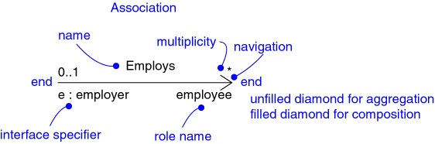
Relationships
Association
  Aggregation
  Composition
Inheritance
1-<number>
Notes:
Don’t cover the details of the graphic on this slide. The semantics of each of the relationships will be discussed later.

Slide 20
Relationships: Association
Models a semantic connection among classes
Association Name
Professor
Works for
University
Association
Role Names
Class
Professor
University
Employee
Employer
1-<number>
Notes:
Associations connect instances of two or more classes together for some duration (as opposed to a dependency relationship, which represents a temporary association between two instances).
Dependency relationships will be discussed in the Class Design module.
Do not use relationship/role names if they add no value/information to the model. Remember, readability and understandability of the model are key -- only add information that adds value, not clutter to the diagrams.

Slide 21
Relationships: Aggregation
A special form of association that models a whole-part relationship between an aggregate (the whole) and its parts
Whole
Part
Student
Schedule
Aggregation
1-<number>
Notes:
There are many examples of whole-part relationships: a Library contains Books, within a company Departments are made-up of Employees, a Computer is composed of a number of Devices. However, whether you model a relationship as an association or aggregation is really dependent on the domain being modeled. This is discussed in more detail on a later slide.

Slide 22
Relationships: Composition
A form of aggregation with strong ownership and coincident lifetimes
  The parts cannot survive the whole/aggregate
Whole
Part
Student
Schedule
Aggregation
1-<number>
Notes:
Explain to the students that the diamond on this slide must be filled in with black so that the books would print right. If it was filled in with white, it would not be filled in in the books.
Note: Compositional aggregation can be shown in by nesting one class within another; however, Rose does not directly support the drawing of a class within a class.
Composition is not equivalent to containment by value, as some languages do not support containment by value (e.g., Java). By-value vs. by-reference is an implementation “thing”, whereas composition is a conceptual “thing” that can realized in the implementation using by-value, or by-reference (if the distinction is supported).
Note: In Rose, composition is modeled by specifying “by-value” for the containment property of a role of a relationship.

Slide 23
Association: Multiplicity and Navigation
Multiplicity defines how many objects participate in a relationships
  The number of instances of one class related to ONE instance of the other class
  Specified for each end of the association
Associations and aggregations are bi-directional by default, but it is often desirable to restrict navigation to one direction
  If navigation is restricted, an arrowhead is added to indicate the direction of the navigation
1-<number>

Slide 24
Association: Multiplicity
Unspecified
Exactly one
Zero or more (many, unlimited)
One or more
Zero or one
Specified range
Multiple, disjoint ranges
1
0..*
*
1..*
0..1
2..4
2, 4..6
1-<number>
Notes:
Specification of multiplicity flushes out business rules and assumptions. The lower bound is critical, as the lower bound is what determines whether or not the relationship is optional (e.g., a lower bound of 0 indicates that the relationship is optional).
Multiplicity is needed on both ends of a relationship, even if you can only navigate in one direction. Even though there is no need to navigate in that direction, the multiplicity still provides valuable business information. Sometimes navigation decisions are made for performance reasons, which may change over time. The multiplicity should reflect the requirements.
Navigation is discussed on later slides.
The use of ‘N’ instead of ‘*’ is Booch, not UML (e.g., the use of “0..N” and ‘N’ is not UML).

Slide 25
Example: Multiplicity and Navigation
Multiplicity
Student
1
Schedule
0..*
Navigation
1-<number>

Slide 26
Example: Single Inheritance
One class inherits from another
Ancestor
Account
balance
Superclass (parent)
name
number
Withdraw()
CreateStatement()
Generalization Relationship
Checking
Savings
Subclasses
Withdraw()
GetInterest()
Withdraw()
Descendents
1-<number>

Slide 27
Example: Multiple Inheritance
A class can inherit from several other classes
FlyingThing
Animal
multiple
inheritance
Airplane
Helicopter
Bird
Wolf
Horse
Use multiple inheritance only when needed, and
always with caution !
1-<number>

Slide 28
What Gets Inherited?
A subclass inherits its parent’s attributes, operations, and relationships
A subclass may:
  Add additional attributes, operations, relationships
  Redefine inherited operations (use caution!)
Common attributes, operations, and/or relationships are shown at the highest applicable level in the hierarchy
Inheritance leverages the similarities among classes
1-<number>
Notes:
Emphasize that when a change is made to a super class all descendent classes inherit the change.
Some languages do not support generalization. In these cases you will need to update the design model to reflect the characteristics of the implementation language. In cases where the implementation language does not support generalization between classes you must “design generalization in”. See the language specific appendices for more information. See Class Design for more information.

Slide 29
Example: What Gets Inherited
GroundVehicle
Person
Superclass (parent)
weight
owner
licenseNumber
0..*
1
register( )
generalization
Car
Truck
Trailer
Subclass
size
tonnage
getTax( )
1-<number>
Notes:
Ask the class the following to test their understanding:
“Without looking at your notes:
How many operations does Car have?
Answer: 1
How may relationships?
Answer: 1
How many operations does Truck have?
Answer: 2
How may relationships?
Answer: 2”
Generalization provides a way to implement polymorphism in cases where polymorphism is implemented the same way for a set of classes. The use of generalization to support polymorphism is discussed in more detail in the Class Design module

Slide 30
Data Flow Diagrams
These slides are adapted from notes by Dennis & Haley Wixom
1-<number>

Slide 31
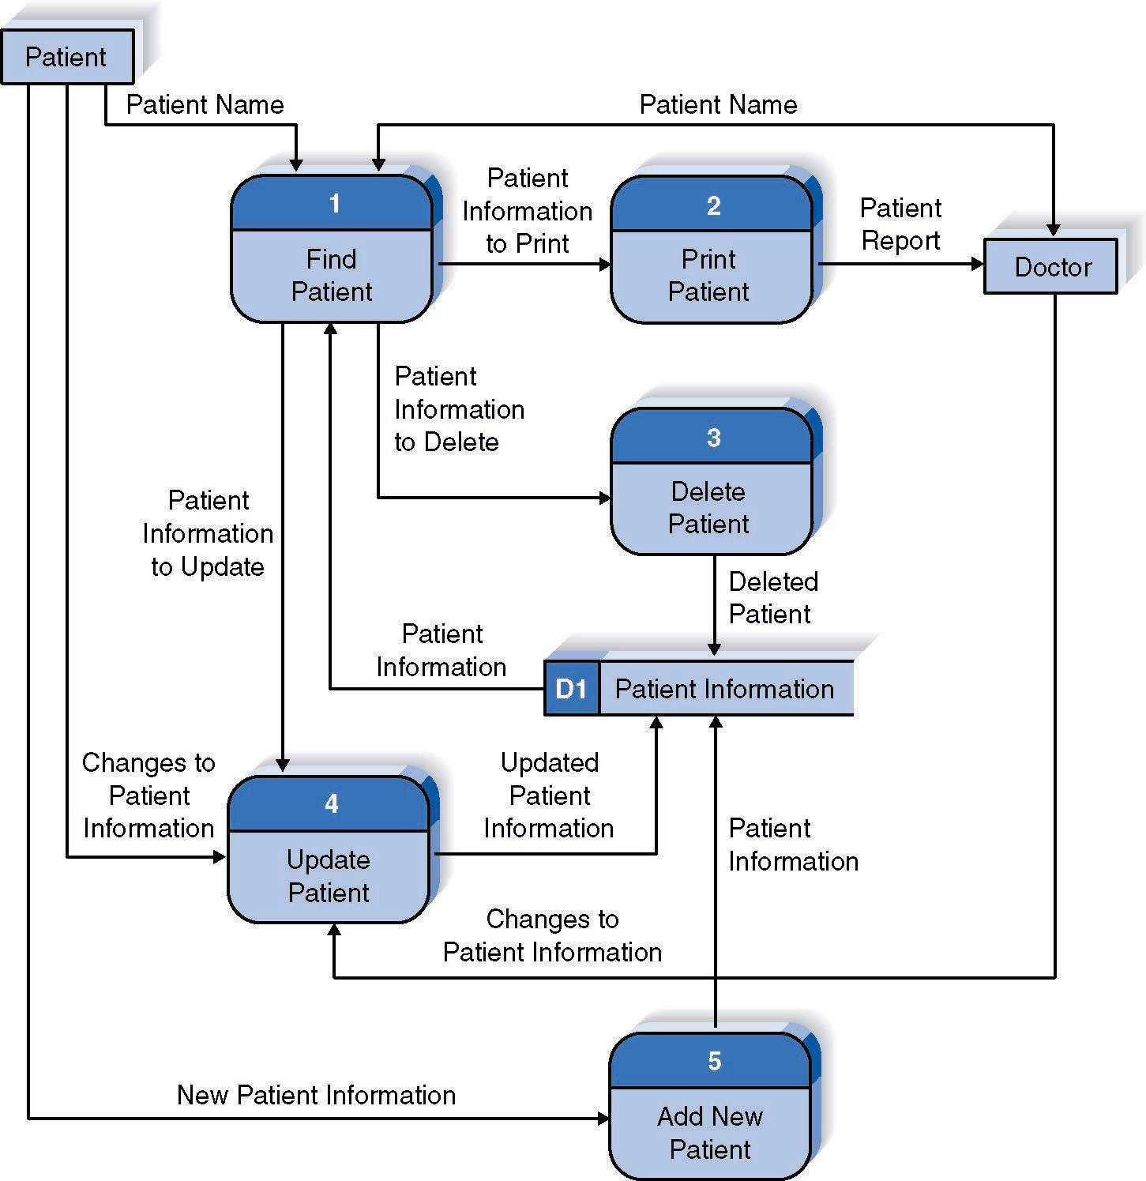
Reading a DFD
1-<number>

Slide 32
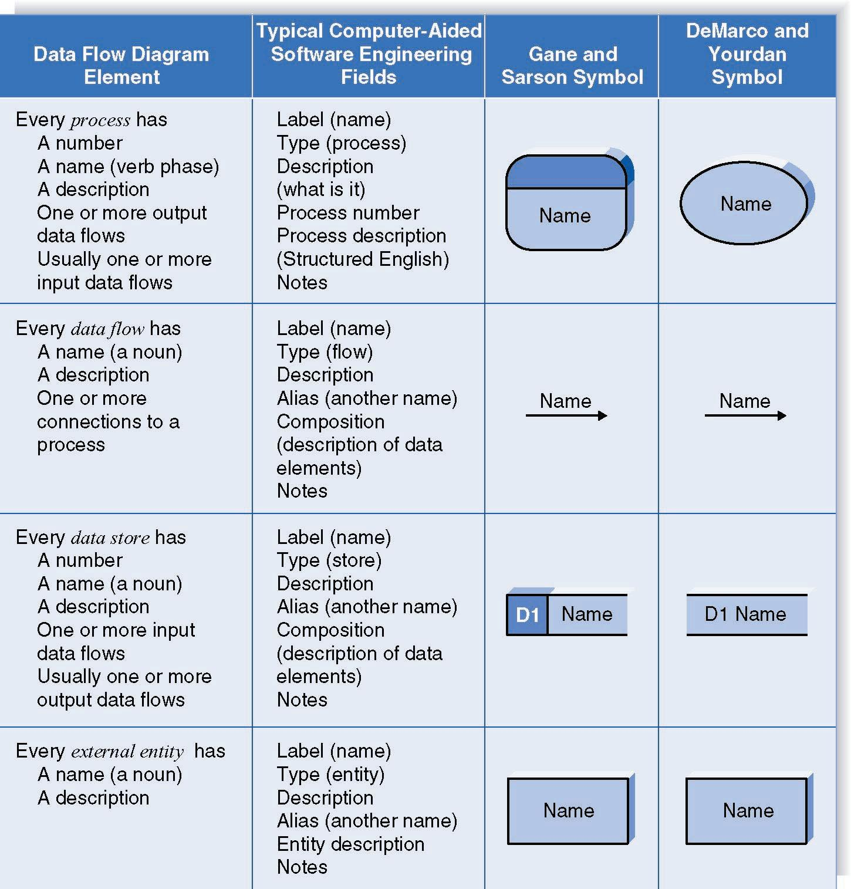
DFD Elements
1-<number>

Slide 33
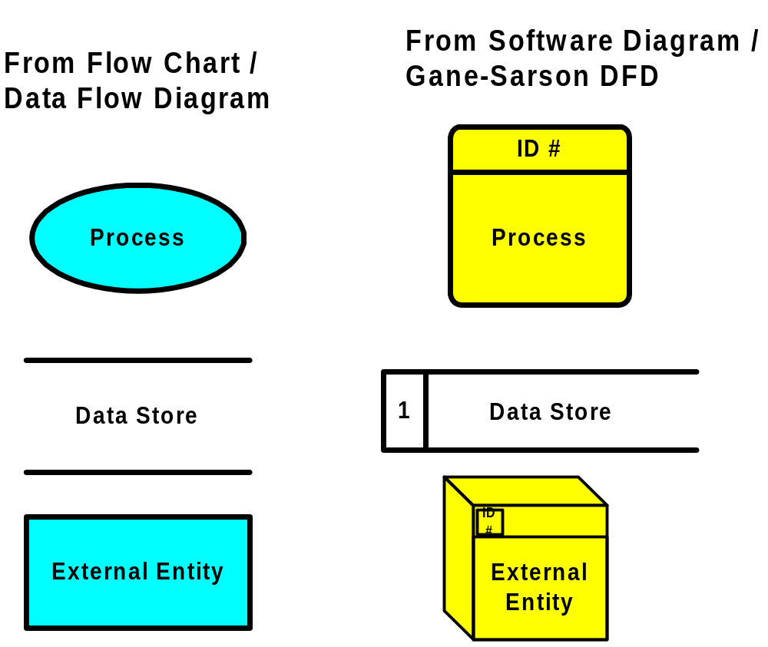
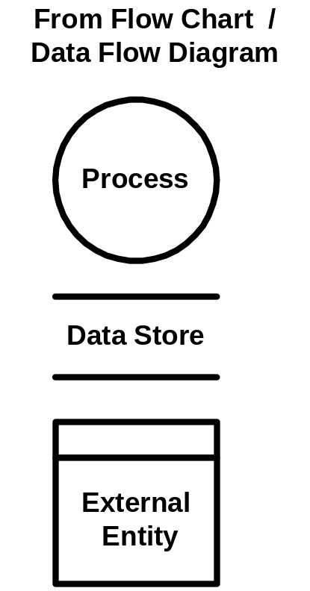
DFD Shapes from Visio
Visio 5.x
Visio 2000
1-<number>

Slide 34
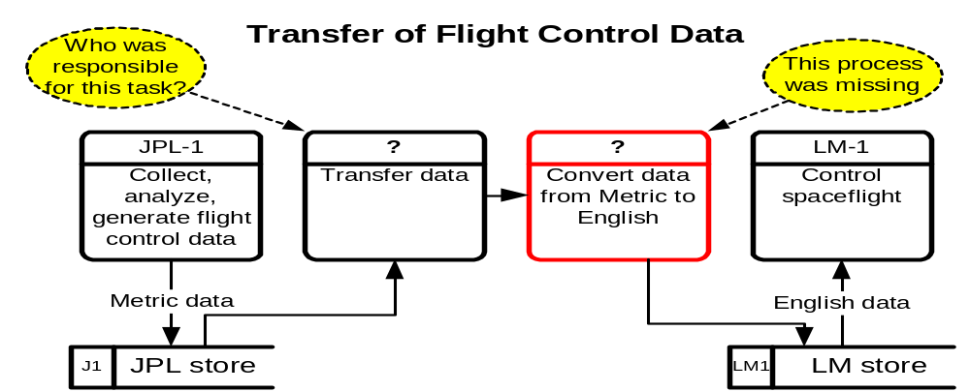
DFD – Practical Example
Launched Dec. 11, 1998, the Climate Orbiter plunged too steeply into the Martian atmosphere Sept. 23, 1999, and either burned up or crashed. In an initial failure report released Oct. 15, 2000 the review board blamed the navigation error on a communications foul-up between NASA's Jet Propulsion Laboratory and prime contractor Lockheed Martin.
1-<number>

Slide 35
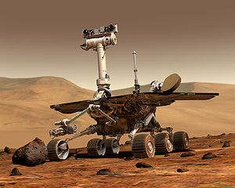
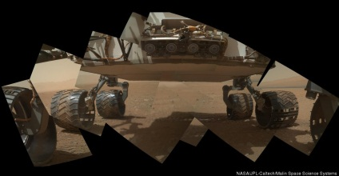

DFD – Practical Example
Launched Dec. 11, 1998, the Climate Orbiter plunged too steeply into the Martian atmosphere Sept. 23, 1999, and either burned up or crashed. In an initial failure report released Oct. 15, 2000 the review board blamed the navigation error on a communications foul-up between NASA's Jet Propulsion Laboratory and prime contractor Lockheed Martin.
1-<number>

Slide 36
Structured English
Common Statements Example
Action Statement Profits = Revenues - Expenses
Generate Inventory - Report
Add Product record to Product Data Store
If Statement IF Customer Not in Customer Data Store
THEN Add Customer record to Customer Data Store
ELSE Add Current-Sale to Customer’s Total-Sales
Update Customer record in Customer Data Store
For Statement FOR all Customers in Customer Data Store
Generate a new line in the Customer-Report
Add Customer’s Total-Sales to Report-Total
Case Statement CASE
If Income < 10,000: Marginal-tax-rate = 10%
If Income < 20,000: Marginal-tax-rate = 20%
If Income < 30,000: Marginal-tax-rate = 31%
If Income < 40,000: Marginal-tax-rate = 35%
ELSE Marginal-tax-rate = 38%
ENDCASE
1-<number>

Slide 37
Key Definition
Decomposition is the process of modeling the system and its components in increasing levels of detail.
Balancing involves insuring that information presented at one level of a DFD is accurately represented in the next level DFD.
1-<number>

Slide 38
Context Diagram
Shows the context into which the business process fits
Shows the overall business process as just one process
Shows all the outside entities that receive information from or contribute information to the system
1-<number>

Slide 39
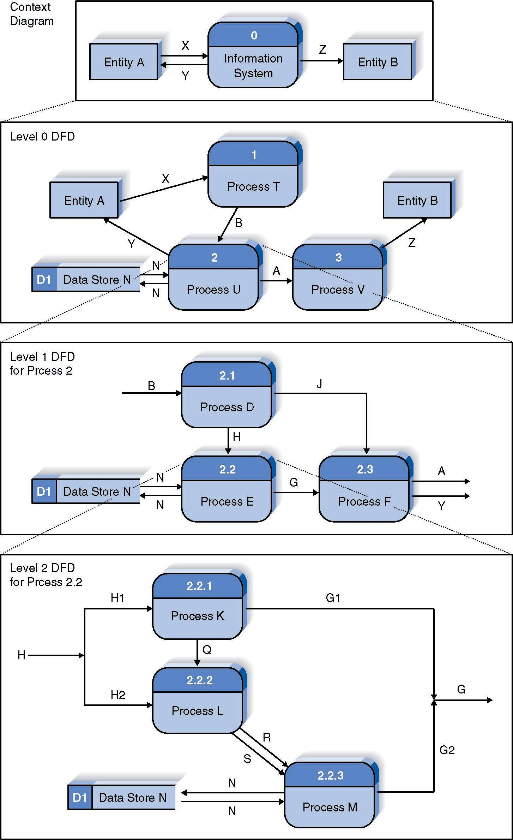
Relationship Among DFD levels
1-<number>

Slide 40
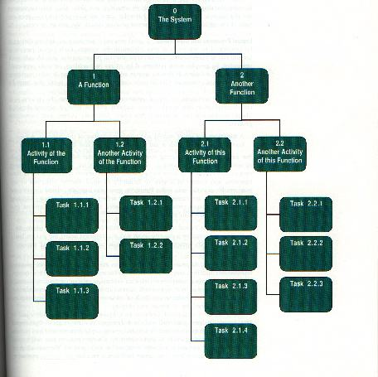
Decomposition Diagram
1-<number>

Slide 41
Level 0 Diagram
Shows all the processes that comprise the overall system
Shows how information moves from and to each process
Adds data stores
1-<number>

Slide 42
Level 1 Diagrams
Shows all the processes that comprise a single process on the level 0 diagram
Shows how information moves from and to each of these processes
Shows in more detail the content of higher level process
Level 1 diagrams may not be needed for all level 0 processes
1-<number>

Slide 43
Level 2 Diagrams
Shows all processes that comprise a single process on the level 1 diagram
Shows how information moves from and to each of these processes
Level 2 diagrams may not be needed for all level 1 processes
Correctly numbering each process helps the user understand where the process fits into the overall system
1-<number>

Slide 44
Data Flow Splits and Joins
A data flow split shows where a flow is broken into its component parts for use in separate processes
Data flow splits need not be mutually exclusive nor use all the data from the parent flow
As we move to lower levels we become more precise about the data flows
A data flow join shows where components are merged to describe a more comprehensive flow
1-<number>

Slide 45
Alternative Data Flows
Where a process can produce different data given different conditions
We show both data flows and use the process description to explain why they are alternatives
Tip -- alternative data flows often accompany processes with IF statements
1-<number>

Slide 46
Creating Data Flow Diagrams
1-<number>

Slide 47
Integrating Scenario Descriptions
DFDs generally integrate scenario descriptions
Names of use cases become processes
Names of inputs and outputs become data flows
Combining “small” data inputs and outputs into a single flow
1-<number>

Slide 48
Steps in Building DFDs
Build the context diagram
Create DFD fragments for each scenario
Organize DFD fragments into level 0
Decompose level 0 DFDs as needed
Validate DFDs with user
1-<number>

Slide 49
DFD Fragment Tips
All process names must be verb phrases
Maintain organization’s viewpoint in naming processes
Layouts often place
  processes in the center
  inputs from the left
  outputs to the right
  stores beneath the processes
1-<number>

Slide 50
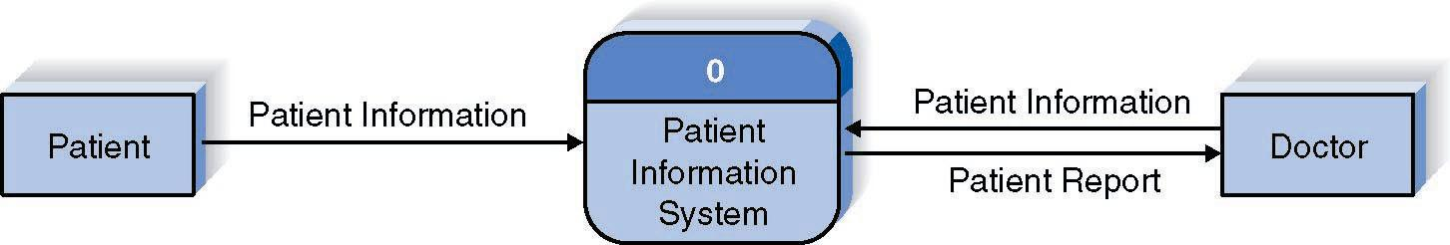
A DFD Fragment Example
1-<number>

Slide 51
DFD Common Errors
A processing step may have input flows but no output flows. This situation is sometimes called a black hole.
A processing step may have output flows but no input flows. This situation is sometimes called a miracle.
A processing step may have outputs that are greater than the sum of its inputs - e.g., its inputs could not produce the output shown. This situation is sometimes referred to as a grey hole.
1-<number>

Slide 52
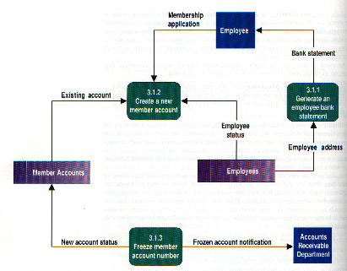
DFD – Common Errors
Black Hole
Gray Hole
Miracle
1-<number>

Slide 53
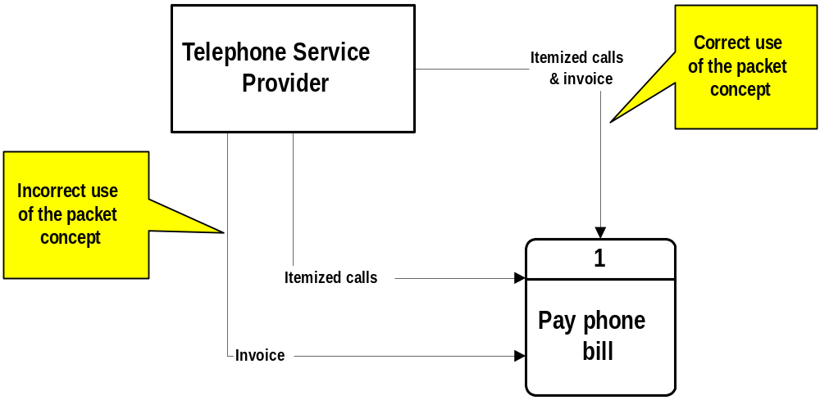
DFD – Packet Concept
1-<number>

Slide 54
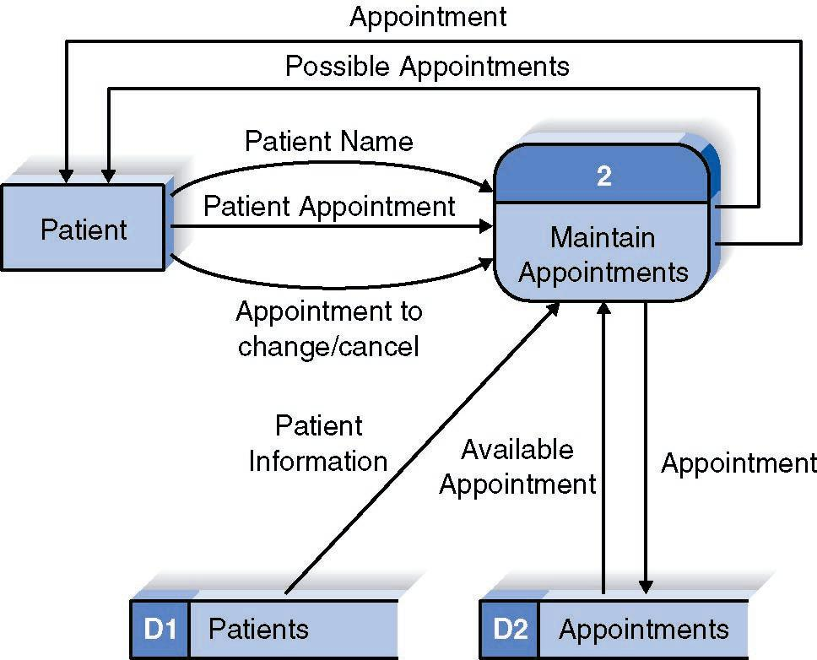
A Second DFD Fragment Example
1-<number>

Slide 55
Level 0 Tips
Generally move from top to bottom, left to right
Minimize crossed lines
Iterate as needed
  The DFD is often drawn many times before it is finished, even with very experienced systems analysts
1-<number>

Slide 56
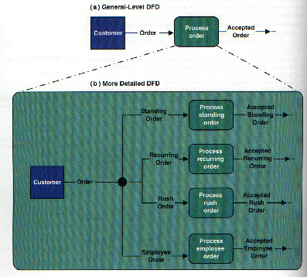
Composite & Elementary Flows
1-<number>

Slide 57
Tips for Level 1 and Below
Sources for inputs and outputs listed at higher level
List source and destination of data flows to processes and stores within each DFD
Depth of DFD depends on overall system complexity
  Two processes generally don’t need lower level
  More than seven processes become overly complex and difficult to read
1-<number>

Slide 58
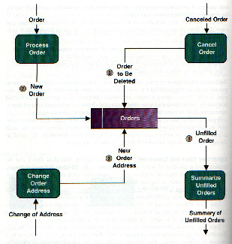
Flows to & from Data Stores
1-<number>

Slide 59
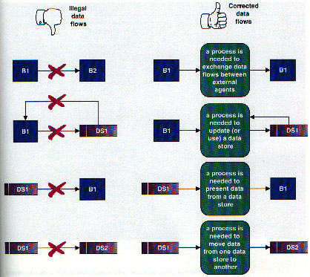
Illegal Data Flows
1-<number>

Slide 60
Example of Incorrect DFD
Patient name
Patient
Appointments
D1
Appointment
1-<number>

Slide 61
Validating the DFD
Syntax errors
  Assure correct DFD structure
Semantics errors
  Assure accuracy of DFD relative to actual/desired business processes
User walkthroughs
Role-play processes
Examine lowest level DFDs
Examine names carefully
1-<number>

Slide 62
Summary
The Data Flow Diagram (DFD) is an essential tool for creating formal descriptions of business processes and data flows.
Use cases record the input, transformation, and output of business processes.
Eliciting scenario descriptions and modeling business processes are critically important skills for the systems analyst to master.
1-<number>

